Slide 1
CHAPTER 1
INTRODUCTION
Chapter Outline
Historical Perspective
Stone → Bronze → Iron → Advanced materials
What is Materials Science and Engineering ?
Processing → Structure → Properties → Performance
Classification of Materials
Metals, Ceramics, Polymers, Composites, Semiconductors, Biomaterials
Advanced Materials
Electronic materials, superconductors, etc.
Modern Material's Needs, Material of Future
Biodegradable materials, Nanomaterials, “Smart” materials

Slide 2
Historical Perspective
Beginning of the Material Science - People began to make tools from stone – Start of the Stone Age about two million years ago.
Natural materials: stone, wood, clay, skins, etc.
The Stone Age ended about 5000 years ago with introduction of Bronze in the Far East. Bronze is an alloy (a metal made up of more than one element), copper + < 25% of tin + other elements.
Bronze: can be hammered or cast into a variety of shapes, can be made harder by alloying, corrode only slowly after a surface oxide film forms.
The Iron Age began about 3000 years ago and continues today. Use of iron and steel, a stronger and cheaper material changed drastically daily life of a common person.
Age of Advanced materials: throughout the Iron Age many new types of materials have been introduced (ceramic, semiconductors, polymers, composites…). Understanding of the relationship among structure, properties, processing, and performance of materials. Intelligent design of new materials.

Slide 3
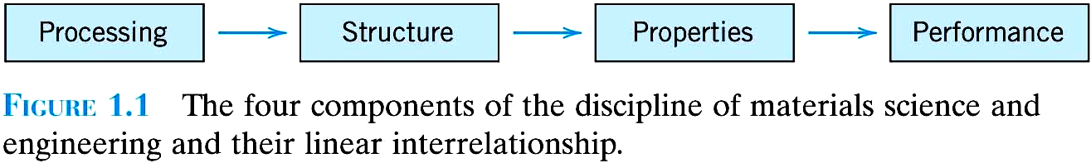
材料科學工程要素
製程 (processing)
結構 (structure)
性質 (property)
功能 (performance)
Material science is the investigation of the relationship among processing, structure, properties, and performance of materials.

Slide 4
結構(structure)
原子結構 (atomic)
微觀結構 (microscopic)
巨觀結構 (macroscopic)
Structure
The arrangement of internal components of matter
Electronic: on a subatomic level
Crystal: on an atomic level
Microstructure: on a microscopic level

Slide 5
Subatomic level
Electronic structure of individual atoms that defines interaction among atoms (interatomic bonding).
Atomic level
Arrangement of atoms in materials (for the same atoms can have different properties, e.g. two forms of carbon: graphite and diamond)
Microscopic structure
Arrangement of small grains of material that can be identified by microscopy.
Macroscopic structure
Structural elements that may be viewed with the naked eye.

Slide 6
Length-scales
Angstrom = 1Å = 1/10,000,000,000 meter = 10⁻¹⁰ m
Nanometer = 1 nm = 1/1,000,000,000 meter = 10⁻⁹ m
Micrometer = 1µm = 1/1,000,000 meter = 10⁻⁶ m
Millimeter = 1mm = 1/1,000 meter = 10⁻³ m

Slide 7
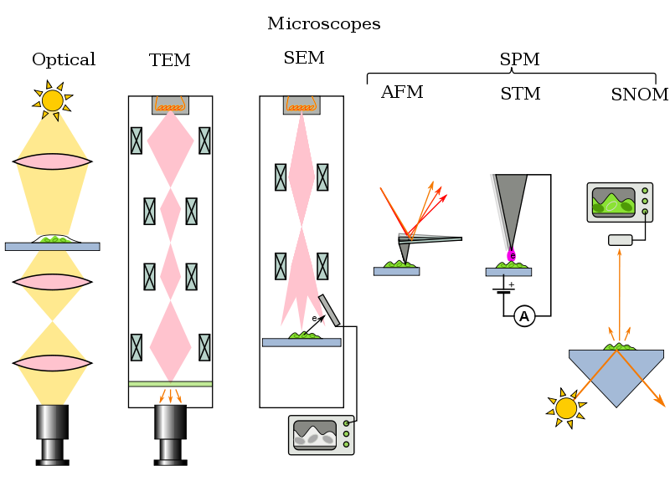

Slide 8
Properties :
mechanical
electrical
thermal
magnetic
optical
radiative
bio-compatible
……..

Slide 9
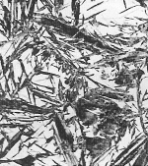
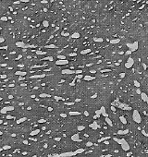
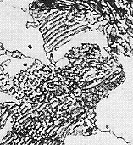
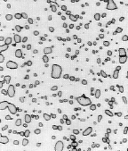
Structure, Processing, & Properties
• Properties depend on structure
ex: hardness vs structure of steel
(d)
6
00
5
00
30 μm
(c)
4
00
(b)
(a)
Hardness (BHN)
3
00
4 μm
2
00
30 μm
30 μm
100
0.01
0.1
1
10
100
1000
Cooling Rate (ºC/s)
• Processing can change structure
ex: structure vs cooling rate of steel

Slide 10
ELECTRICAL
• Electrical Resistivity of Copper:
6
5
Cu + 3.32 at%Ni
4
Cu + 2.16 at%Ni
Resistivity, ρ
deformed Cu + 1.12 at%Ni
3
(10⁻⁸ Ohm-m)
2
Cu + 1.12 at%Ni
1
“Pure” Cu
0
-200
-100
0
T (°C)
• Adding “impurity” atoms to Cu increases resistivity.
• Deforming Cu increases resistivity.

Slide 11
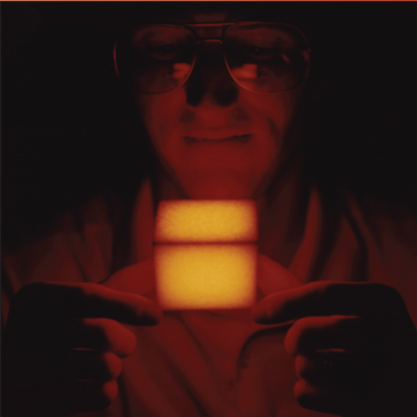
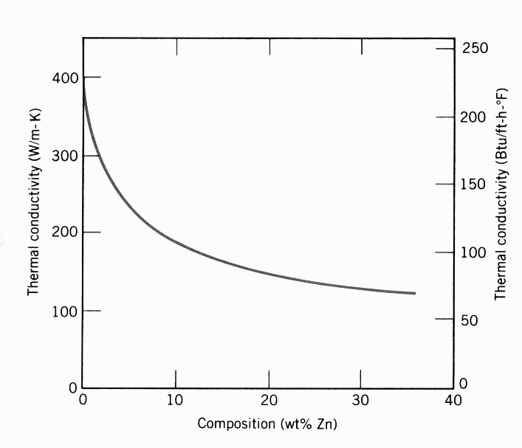
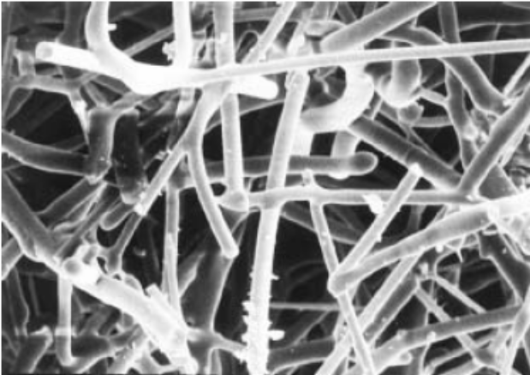
THERMAL
• Space Shuttle Tiles:
--Silica fiber insulation
offers low heat conduction.
• Thermal Conductivity
of Copper:
--It decreases when
you add zinc!
400
300
(W/m-K)
200
Thermal Conductivity
100
0
0
10
20
30
40
Composition (wt% Zinc)
100 μm

Slide 12
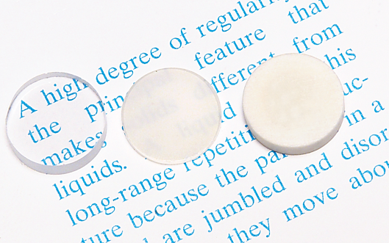
OPTICAL
• Transmittance:
--Aluminum oxide may be transparent, translucent, or
opaque depending on the material structure.
polycrystal:
low porosity
polycrystal:
high porosity
single crystal

Slide 13

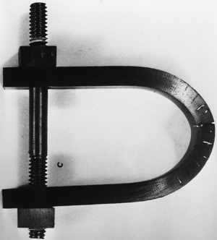
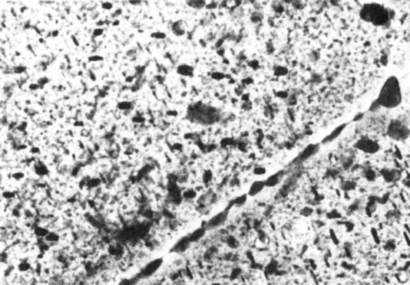
DETERIORATIVE
• Heat treatment: slows
crack speed in salt water!
• Stress & Saltwater...
--causes cracks!
10
-8
“as-is”
“held at
160ºC for 1 hr
crack speed (m/s)
before testing”
10
-10
Alloy 7178 tested in
saturated aqueous NaCl
solution at 23ºC
increasing load
--material:
7150-T651 Al "alloy"
(Zn,Cu,Mg,Zr)
4 μm

Slide 14
材料選用
特性
使用期間劣化情況
成本

Slide 15
The Materials Selection Process
1.
Pick Application
Determine required Properties
Properties: mechanical, electrical, thermal,
magnetic, optical, deteriorative.
2.
Properties
Identify candidate Material(s)
Material: structure, composition.
3.
Material
Identify required Processing
Processing: changes structure and overall shape
ex: casting, sintering, vapor deposition, doping
forming, joining, annealing.

Slide 16
材料分類
金屬 (Metal)
陶瓷 (Ceramics)
高分子 (Polymers)
複合材料 (Composites)
半導體 (Semiconductors)
生物材料 (Biomaterials)

Slide 17
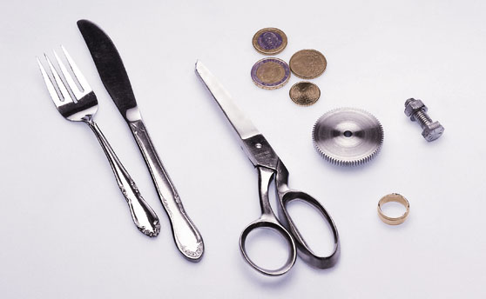
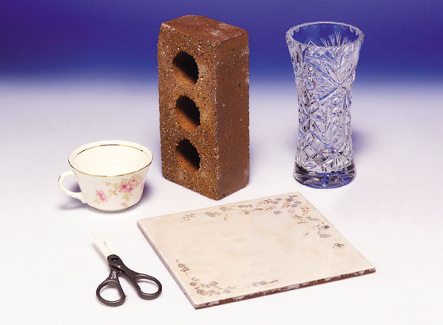
Types of Materials
Let us classify materials according to the way the atoms are bound together .
Metals: valence electrons are detached from atoms, and spread in an 'electron sea' that "glues" the ions together. Strong, ductile, conduct electricity and heat well, are shiny if polished.
-Strong, ductile
  -high thermal & electrical conductivity
  -opaque, reflective.
Ceramics: atoms behave like either positive or negative ions, and are bound by Coulomb forces. They are usually combinations of metals or semiconductors with oxygen, nitrogen or carbon (oxides, nitrides, and carbides). Hard, brittle, insulators. Examples: glass, porcelain.
  -Brittle, glassy
  -non-conducting (insulators)

Slide 18
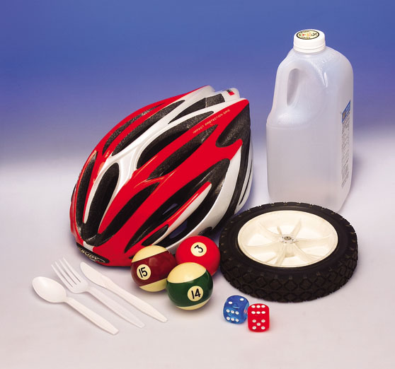
Polymers: are bound by covalent forces and also by weak van der Waals forces, and usually based on C and H. They decompose at moderate temperatures (100 – 400 ℃), and are lightweight. Examples: plastics rubber.
  -Soft, ductile, low strength, low density
  -thermal & electrical insulators
  -Optically translucent or transparent.
Semiconductors: the bonding is covalent (electrons are shared between atoms). Their electrical properties depend strongly on minute proportions of contaminants. Examples: Si, Ge, GaAs.

Slide 19
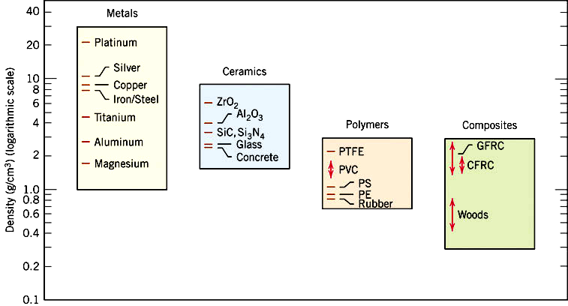

Slide 20
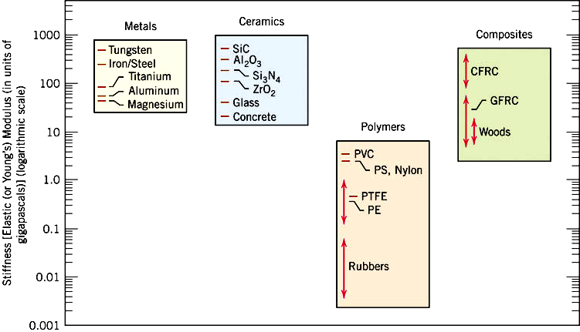

Slide 21
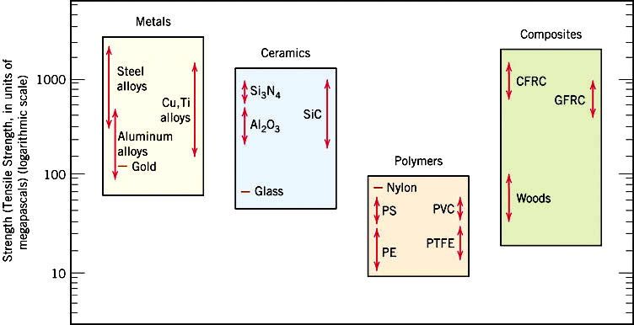

Slide 22
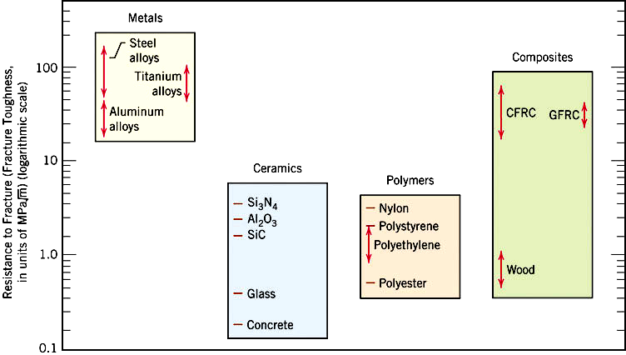

Slide 23
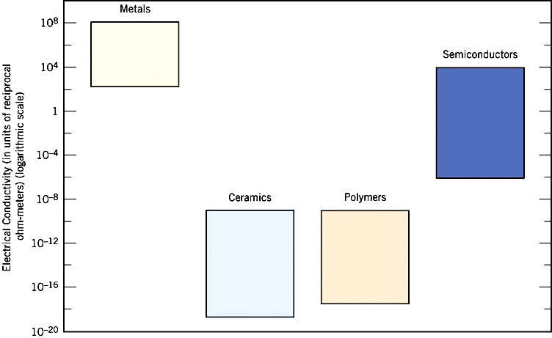

Slide 24
Future of materials science
Design of materials having specific desired characteristics directly from our knowledge of atomic structure.
Miniaturization: “Nanostructured" materials, with microstructure that has length scales between 1 and 100 nanometers with unusual properties. Electronic components, materials for quantum computing.
Smart materials: airplane wings that deice themselves, buildings that stabilize themselves in earthquakes…
Environment-friendly materials: biodegradable or photodegradable plastics, advances in nuclear waste processing, etc.
Learning from Nature: shells and biological hard tissue can be as strong as the most advanced laboratory-produced ceramics, mollusces produce biocompatible adhesives that we do not know how to reproduce…
Materials for lightweight batteries with high storage densities, for turbine blades that can operate at 2500°C, room-temperature superconductors? chemical sensors (artificial nose) of extremely high sensitivity, cotton shirts that never require ironing…

Slide 25


Slide 26
SUMMARY
Types of materials (metals, ceramics, polymers,
composites , semiconductors, biomaterials)
Properties of materials (mechanical, thermal,
electrical, optical, …….)
Different levels of structure in materials (atomic,
microscopic, macroscopic)
Relation among material processing, structure,
properties, and performance

